Slide 1
Today’s Objective
Inline Functions
Default Arguments

Slide 2
Functions
Objective of using functions in a program is to save some code memory space, increase modularity, good and neat software design
Every time a function is called, it takes a lot of extra time in executing a series of instructions for tasks such as
  jumping to the function
  saving registers
  pushing arguments into the stack
  returning to the calling functions
When a function is large, a substantial percentages of executing time may be spent in such overheads
But when function is small we shall try to find alternative solutions

Slide 3
Inline function (cont…)
To eliminate the cost of calls to small functions, C++ proposes a new feature called inline function
Although placing inline keyword only gives compiler a hint that this function can be optimized by doing in-lining, its ultimately compiler decision to make it inline

Slide 4
Syntax of inline function
inline return-type function-name(parameters)
{
// function code
}

Slide 5
Basketball Team
A college has ‘n’ basketball players. A 5-member team and a captain has to be selected for each team out of these ‘n’ players. How many different selections can be made?
Let us assume the value of n as 10

Slide 6
Basketball Team
A team of 6 members has to be selected from the 10 players.
This can be done in 10C₆ or 210 ways.
Now, the captain can be selected from these 6 players in 6 ways.
Therefore, total ways the selection can be made is 210*6 = 1260.

Slide 7
Basketball Team
Alternatively, we can select the 5 member team out of the 10 in 10C₅ ways = 252 ways
The captain can be selected from amongst the remaining 5 players in 5 ways.
Therefore, total ways the selection of 5 players and a captain can be made = 252*5 = 1260.

Slide 8

Combinations
Both the solutions have to find combinations
Formula for finding combination is:
Factorial has to be computed thrice
Function shall be written for computing factorial

Slide 9
PAC for Basket Ball Team Problem
Input | Output | Logic
Read a number ‘n’ | Number of possible ways to form the teams | Find combinations

Slide 10
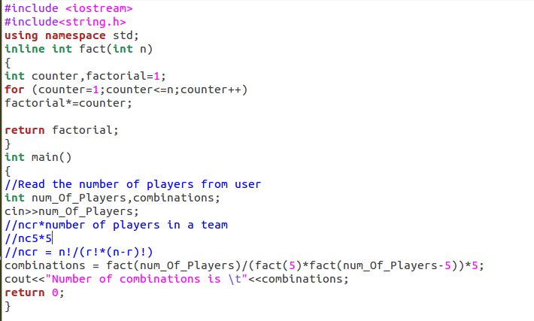

Slide 11
Advantages of inline function
Function call overhead doesn’t occur.
It also saves the overhead of push/pop variables on the stack when function is called.
It also saves overhead of a return call from a function.
After in-lining compiler can also apply intraprocedural optimization if specified
Increases locality of reference by utilizing instruction cache

Slide 12
Disadvantages of inline function
May increase function size so that it may not fit on the cache, causing lots of cache miss
After in-lining function if variables number which are going to use register increases than they may create overhead on register variable resource utilization
It may cause compilation overhead as if some body changes code inside inline function than all calling location will also be recompiled
If used in header file, it will make your header file size large and may also make it unreadable.
Its not useful for embedded system where large binary size is not preferred at all due to memory size constraints.

Slide 13
Execution of inline function
Please note that, inline is a request to the compiler. If it is very complicated function, compiler may not be able to convert it to inline. Then it will remain as it is. E.g. Recursive function, function containing static variable, function containing return statement or loop or goto or switch statements are not made inline even if we declare them so.

Slide 14
Difference between Macros and Inline Functions
Macros are always expanded by preprocessor, whereas compiler may or may not replace the inline definitions.
Inline follows strict parameter type checking, macros do not.
Can be used for debugging a program as they are expanded at compile time and a break point can be placed at the inline function a definition and step into the method for debugging step by step.
Inline member functions can access the class’s member data.

Slide 15
Default Arguments
Similar to Python, C++ also provides an option for functions to have default arguments
A default argument is a value provided in function declaration that is automatically assigned by the compiler if caller of the function doesn’t provide a value for the argument with default value
Always default arguments must be at the end of the argument list

Slide 16
Function with default arguments
C++ allows us to call a function without specifying all its arguments.
In such cases, the function assigns a default value to the parameter which does not have a matching argument in the function call.
Default values are specified when the function is declared or function defined.

Slide 17
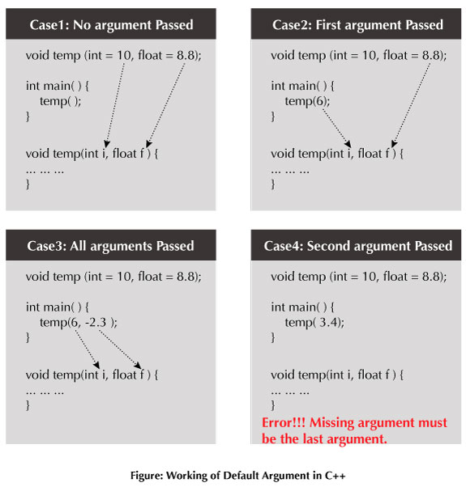
Default arguments (cont…)
Working of default arguments demonstrated in below figures:
Note: The missing argument must be the last argument of the list, that is, if you are passing only one argument in the function, it should be the first argument.

Slide 18
Default arguments (cont…)
Note :
Once default value is used for an argument, all subsequent arguments must have default value.
// Invalid because z has default value, but w after it doesn't have default value
int sum(int x, int y, int z=0, int w)

Slide 19

Default arguments (cont…)
Examples of function declaration with default values are:

Slide 20
Opening an Account in Bank
A software application is developed for a bank
As per the bank rule, to open an account the customer should deposit a minimum of Rs.1000
But it is the desire of the customer to deposit even more
When account is created, name and account number are passed in addition to the minimum deposit made by the customer
A function to create account shall be written in two ways with two arguments or three arguments

Slide 21
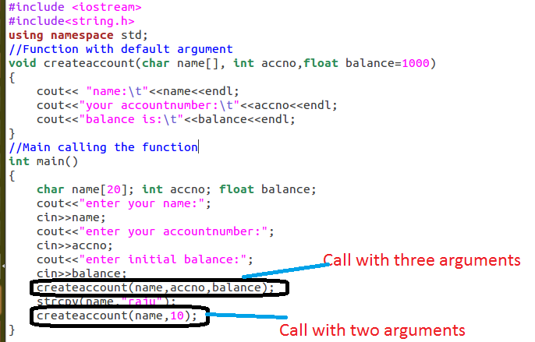

Slide 22
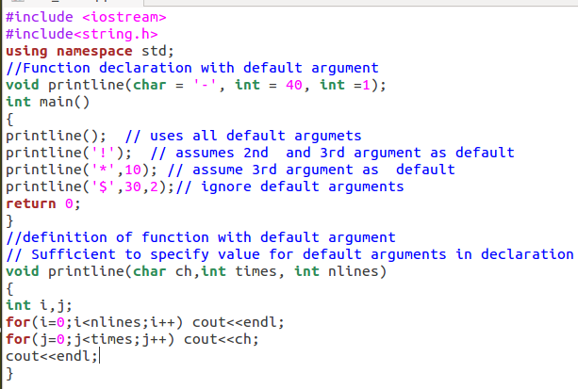

Slide 23
